Slide 1
Real-Time Task Scheduling:
Chapter 2
RAJIB MALL
Professor
Department Of Computer Science & Engineering
IIT Kharagpur.

Slide 2
Organization
  Introduction
  Real-Time task scheduling
    Clock-driven
    Event-driven
  Scheduling of real-time task on a uniprocessor
    Rate Monotonic Analysis (RMA)
    Earliest Deadline First (EDF)
    Scheduling with limited priority levels
  Summary

Slide 3
Introduction
Real-time tasks get generated due to certain event occurrences
  Either internal or external events
For example
  A task may get generated due to a user pressing a switch
When a task gets generated
  It is said to be released or arrived

Slide 4
Real-Time Tasks
  Periodic
    Periodic tasks repeats after a certain fixed time interval
  Sporadic
    Sporadic tasks recurs at random instants
  Aperiodic
    Same as sporadic except that minimum separation between two instances can be 0

Slide 5
Real-Time Task Scheduling
Scheduling of tasks is the primary means by which the operating system meets task deadlines.
So, scheduling is an important problem.
Lot of work has been done in developing appropriate schedulers for real-time tasks
  Scheduling on uniprocessors
  Scheduling on multiprocessors and distributed systems

Slide 6
Important Scheduling Terminologies
  Valid Schedule
    At most one task is assigned to a processor at a time
    No task is scheduled before its time
    Precedence and resource constraints of all tasks are satisfied
  Feasible Schedule
    Valid schedule is one in which all tasks meet their respective time constraints

Slide 7
Important Scheduling Terminologies
  Proficient Scheduler
    Proficient scheduler can feasibly schedule all tasks that other scheduler can but not vice versa
    Equally proficient if both processor can schedule same set of tasks
  Optimal Scheduler
    Optimal scheduler can feasibly schedule any task set that can be scheduled by any other scheduler

Slide 8
Task Scheduling on Uniprocessors
Lots of research has been conducted in the seventies and eighties.
Real-time task scheduling can be
  Clock-driven, or
  Event-driven

Slide 9
Clock-driven Scheduling
Examples
  Table-driven scheduler
  Cyclic scheduler
Decision regarding which job to run next is made at specific time instants
  Timers are used to trigger the decision point
  The joblist along with information regarding which run to be run for how long are stored in a table.

Slide 10
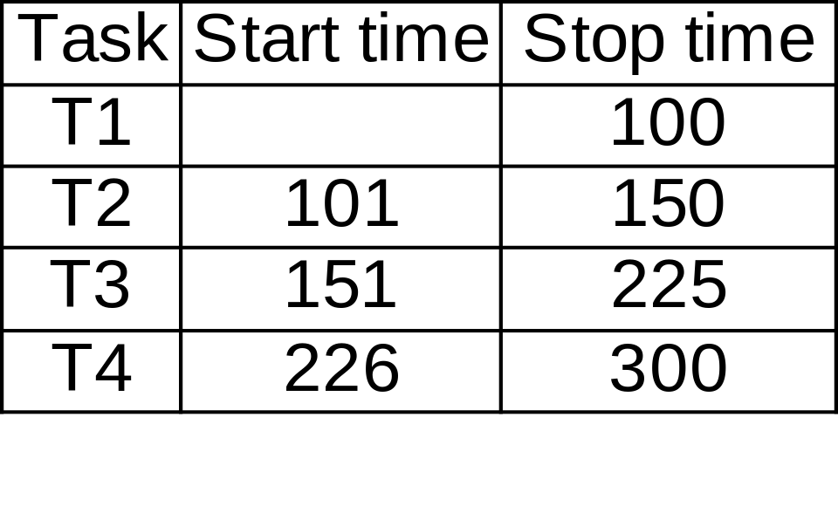
Clock-driven Scheduling

Slide 11
Clock-Driven Scheduling
The scheduler develops a permanent schedule for a period LCM(P1,P2,...,Pn) and stores in a table.
Round robin scheduling is an example of clock-driven scheduling
Clock-driven schedulers are
  Simple: used in low cost applications
  Efficient: very little runtime overhead
  Inflexible: Very difficult to accommodate dynamically changing task set or task characteristics.

Slide 12
Event-Driven Scheduling
  Scheduling points are defined by task completion and arrival events
  These schedulers are generally preemptive
  Simplest example:
    Foreground-Background Scheduler

Slide 13
Event-driven Schedulers
Scheduling decisions are made when certain events occur
    Tasks becoming ready
    Tasks completing execution
These are called preemptive schedulers
  When a higher priority task becomes ready it preempts the executing lower priority task
These are greedy schedulers:
  They never keep the processor idle if a task is ready.

Slide 14
Event-driven Schedulers
Static priority schedulers:
  The task priorities once assigned by the programmers, do not change during runtime
  RMA (Rate Monotonic Algorithm) is the optimal static priority scheduling algorithm
Dynamic priority
  The task priorities can change during runtime based on the relative urgency of completion of tasks
  EDF (Earliest Deadline First) is the optimal uniprocessor scheduling algorithm

Slide 15
Event-Driven Schedulers
First let us consider the simplest scenario:
  Uniprocessor
  Independent tasks
    Tasks do not share resources
    There is no precedence ordering among the tasks

Slide 16
Priority-based Scheduling
Independent tasks executed on a uniprocessor
  Two algorithms pretty much summarise the important results in this scenario
    EDF
    RMA

Slide 17
Foreground-Background Scheduler
  In this scheduler real-time tasks run as foreground tasks
  Sporadic, aperiodic and non-real-time tasks are run as background tasks
  Among the foreground tasks, at every scheduling, highest priority task is scheduled
  Background task can run when no foreground task is ready

Slide 18
EDF
EDF is the optimal uniprocessor scheduling algorithm
  If EDF cannot feasibly schedule a set of tasks, there exists no other scheduling algorithms to do that.
Can schedule both periodic and aperiodic tasks
Schedulability check:
  Sum of utilization due to tasks is less than one.

Slide 19
EDF
EDF is
  Simple
  Optimal
But, is rarely used
  No commercially available operating system directly supports EDF scheduling
  Let us examine the disadvantages of EDF

Slide 20
Disadvantages of EDF
Transient overload handling
  EDF has very poor transient overload handling capability
  When a low-criticality task becomes delayed it can make even the most critical task miss its deadline
  In fact, it is extremely difficult to predict which task would miss its deadline when a task takes more time

Slide 21
Disadvantages of EDF
Runtime efficiency
  EDF is not very efficient
  Inorder to implement EDF the tasks need to be maintained sorted in a priority queue based on their deadline
  The complexity of maintaining a priority queue is logn, where n is the number of tasks

Slide 22
Disadvantages of EDF
Resource sharing among tasks
  It is very difficult to let tasks share non-premptable resources (called critical sections) without some tasks missing their deadlines
  We shall elaborate this problem later in our discussions.

Slide 23
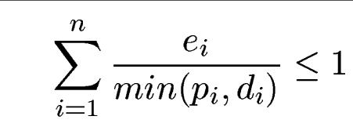
General EDF Schedulability
When the task deadlines differ from the task periods,
  the schedulability criterion needs to be generalized as follows:

Slide 24
RMA
The priority of a task is proportional to its frequency.
  The higher is the frequency (or lower is the period) of a task, the higher is its priority.
Priority
Frequency

Slide 25
RMA
RMA has been shown to be the optimal uniprocessor static priority scheduling algorithm
  If RMA cannot schedule a set of periodic tasks, no other scheduling algorithm can.
Schedulability conditions
  Utilization Bound 1

Slide 26
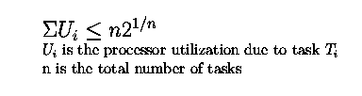
RMA Schedulability
Utilization bound II (Liu and Layland 1971)
U
Utilization

Slide 27
Liu and Layland Condition
The upper bound on utilization converges to 69% (ln2)
  As the number of tasks approaches infinity
The Liu and layland's condition is a conservative result in the sense that
  If a set of tasks passes Liu and Layland test, then it would definitely be schedulable under RMA
  But, even if a set of tasks fails Liu and Layland test, still it may be RMA schedulable.

Slide 28
Example
Consider three periodic tasks
  T1: e1=20mSec, p1=100mSec
  T2: e2=40msec, p2=150mSec
  T3: e3=100mSec, p3=350mSec
The utilization for these 3 tasks are
  0.2+0.267+0.286=0.753
The Liu-Layland bound=3((2)^{1/3}-1)=0.779
  Therefore, the tasks are schedulable.

Slide 29
RMA Schedulability Test
Completion time theorem (Liu and Lehoctzky)
  When a set of tasks meet their first deadlines under zero phasings, then they are RMA schedulable for all task phasings.
This theorem states that if we draw up the schedules till the first deadline of each task and observe that it is schedulable,
  Then the task set would be schedulable
However, drawing up the schedule eould be cumbersome when the number of tasks are large.

Slide 30
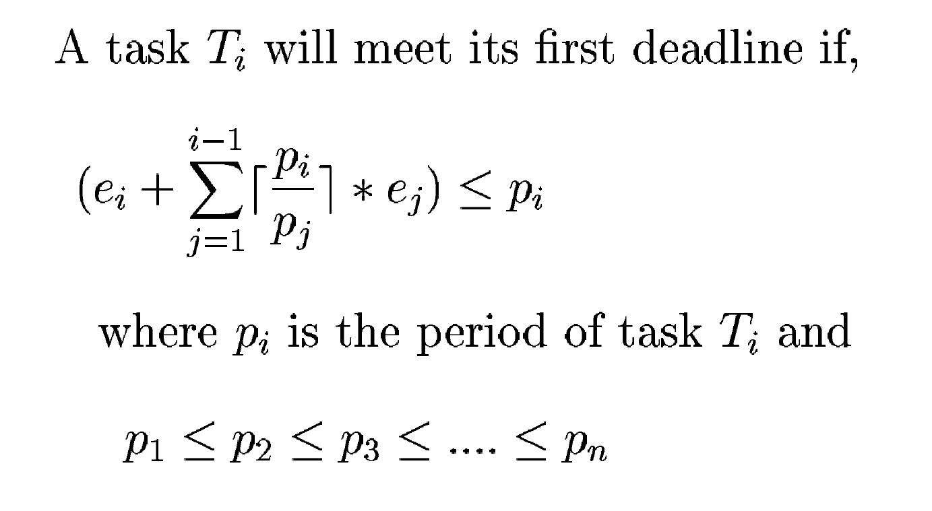
Testing Liu and Lehoctzky's Criterion

Slide 31
Example
Consider three periodic tasks
  T1: e1=20mSec, p1=100mSec
  T2: e2=30mSec, p2=150mSec
  T3: e3=100mSec, p3=250mSec
All three tasks follow Liu-Lehoczky criterion
  Therefore, the tasks are schedulable.

Slide 32
RMA Under Transient Overload
RMS is stable under transient overload conditions:
  If any task starts getting late, then it is guaranteed that it will not affect the higher priority tasks.
  Even when a task is getting late, it must yield the CPU to a higher priority task unlike EDF

Slide 33
Harmonically Related Tasks
A set of periodic tasks are harmonically related, if for every pait of tasks Ti and Tk, if Pi>Pk, then Pi=n*Pk, where n is an integer.
A set of harmonically related tasks are RMA schedulable, if the sum total of their utilization is less than 1.

Slide 34
Insufficient Number of Priorities
All RTOS have a restricted number of priority levels (why?)
  When the number of tasks is more than the number of available priority values, the schedulability of the system decreases.
Assigning priorities using a priority grid:
  Experiments show that the logarithmic grid works the best.

Slide 35
Insufficient Number of Priorities Example
r=(Pmax/Pmin)^{1/nprio}
If Pmin=1msec, Pmax=100,000 and nprio=32
R=1.43
The gridlines become 1.00, 1.43, 2.04, ...

Slide 36
Interrupt Processing Overhead
Defines how long it takes to complete an application
  At a specific interrupt loading
IPO=[(t_{n}-t0)/t₀]*100
t₀=1Sec, t₂₀₀₀₀=1.6 Seconds
IPO=(1.6-1)*100=60 percent

Slide 37
Summary
Scheduling is the primary means by which an operating system tries to meet task constraints
Scheduling of real-time tasks on a uniprocessor
was an area of intense research in the 1970s
  the underlying theory is now well-developed.
In clock-driven schedulers, the scheduling points
are defined by the interrupts generated by the
system clock. Important clock-driven schedulers are
table-based and cyclic.

Slide 38
Summary
Cyclic schedulers are being used in small embedded applications
  due to their simplicity and low run time overhead.
For event-driven scheduling of real-time tasks on a uniprocessor, two algorithms are significant:
  EDF (Earliest Deadline First): This is an optimal dynamic priority scheduling algorithm.
  RMA (Rate Monotonic Analysis):This is an optimal static priority scheduling algorithm

Slide 39
Summary
We discussed the main results concerning how to
determine the schedulability of a set of tasks
  under EDF and RMA.
We also discussed how to overcome some
problems
  that arise while developing a practical real-time system.

